Slide 1
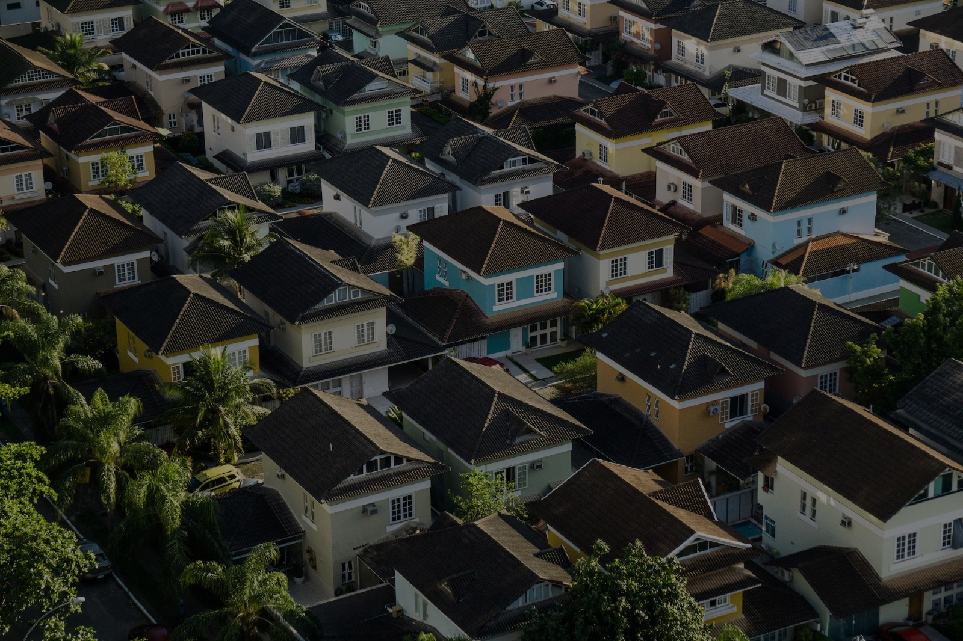
ZILLOW REAL ESTATE INVESTMENT FORECASTING
DSC-PT-03
Phase 4, Group 3
Jonathan Okwaro, Brenda Kinya, Catherine Gakii, Nazra Nyangwara, Bryson Shitsukane, Robin Mutai & Tobias Ng’ong’a

Slide 2
PROJECT OVERVIEW
Boma Yangu real estate investment firm is exploring potential investment options in specific geographic areas in USA.
This project seeks to help the firm to identify the top 5 best zip codes to invest in the next 2 years.
We will build time series models to identify the top 5 best zip codes, and make informed investment recommendations.
We will use Return On Investment ratio to measure best zip codes.
The project uses Return On Investment Ratio to measure the Best Zip Codes.

Slide 3
OBJECTIVES
To provide a recommendation for the top 5 best Zip Codes to invest in, in the next 2 years.
To develop a model that can accurately forecast return on investment from the property market over a specified period of time

Slide 4
DATA UNDERSTANDING
The dataset used was obtained from Zillow Research.
The Zillow dataset has information on real estate prices for various zip codes.
It has 14723 rows and 272 columns.
Each row represents a specific zip code, and the columns contain monthly price data from April 1996 to April 2018.
The dataset also includes additional information such as region IDs, city, state, metro area, county name, and size rank.

Slide 5
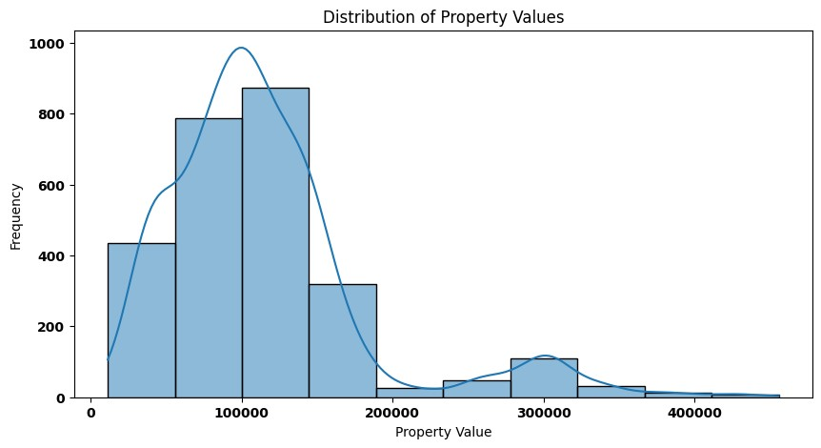
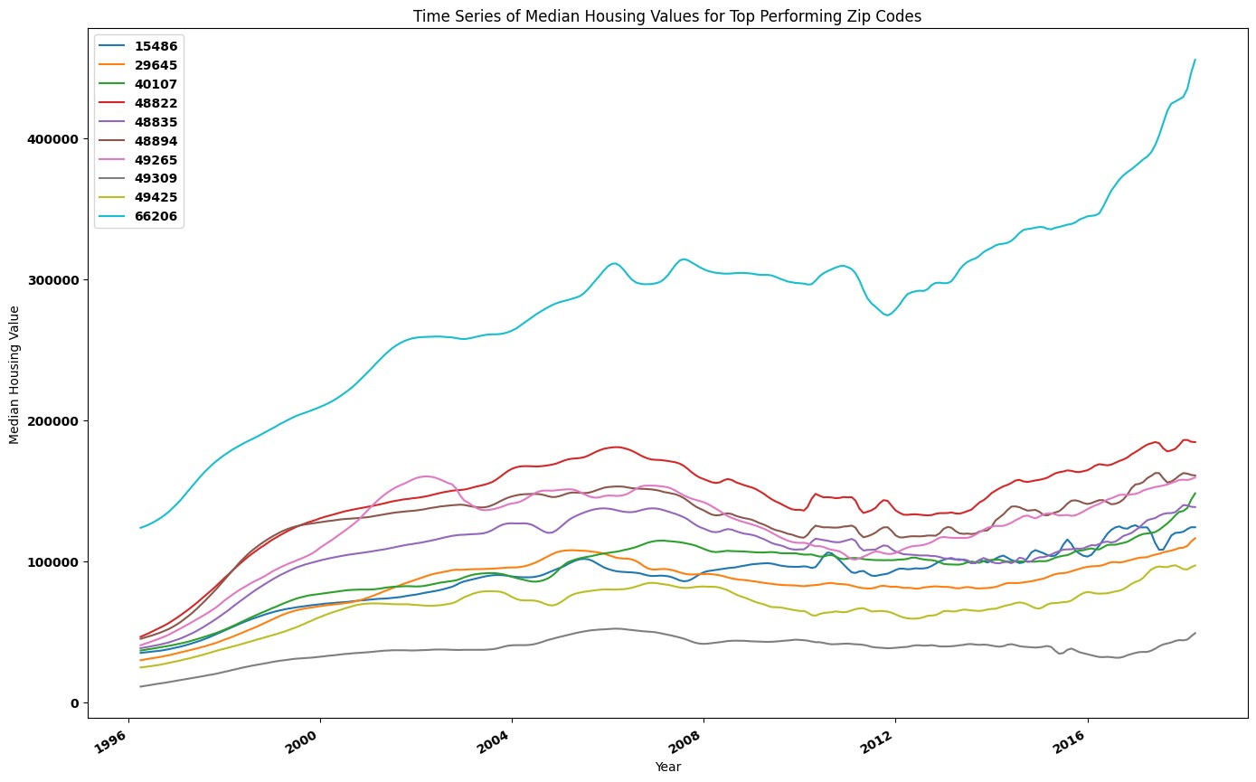
EDA
The majority of the property values are concentrated in the lower price range.
There were noticeable dips around 2008-2010, which correspond with the global financial crisis. After this period, there's a clear recovery and steady growth for most Zip Codes.

Slide 6
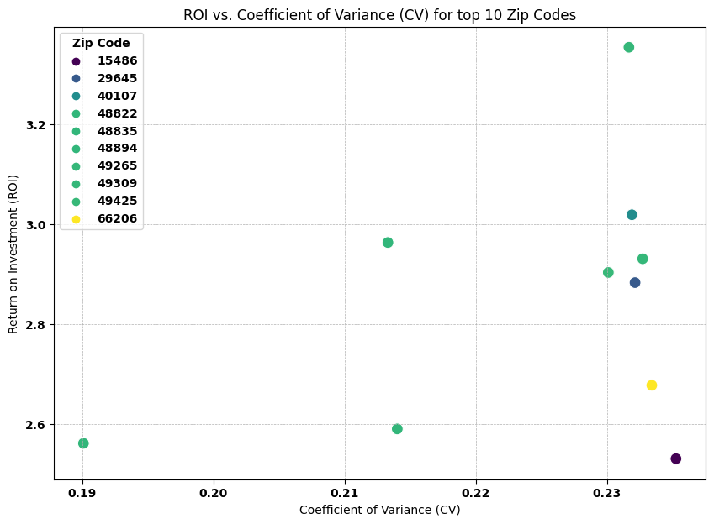
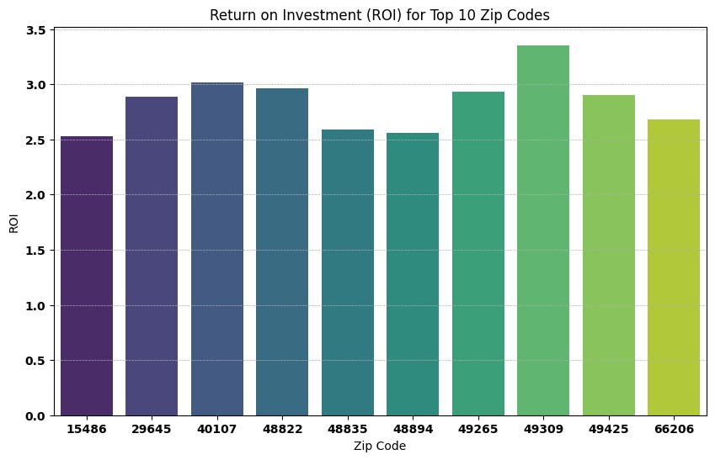
EDA
The Zip Codes closer to the top-left corner offer higher ROI with lower risk, making them more desirable for investment.
Zip Code 49309 has yielded the highest ROI over the years, followed by 40107.

Slide 7
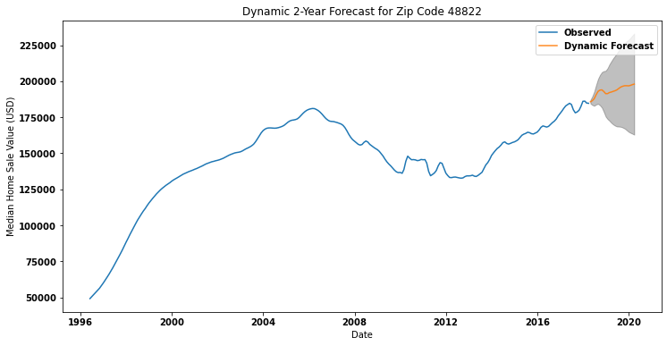
MODELLING – SARIMA MODEL
The model indicate the trend of the forecasting Home Sale Values for the next 2 years.

Slide 8
CONCLUSION
S/NO. | Zip Code | Investment Value ($) | Predicted Sale Prices ($) | Predicted ROI (%) | RMSE
1. | 48822 | 184700.0 | 197993.26 | 7.20 | 1216.52
2. | 49309 | 49200.0 | 51777.49 | 5.24 | 446.12
3. | 29645 | 116500.0 | 118177.38 | 1.44 | 526.42
4. | 48835 | 138600.0 | 138618.56 | 0.01 | 658.92
5. | 49265 | 159600.0 | 158830.09 | -0.48 | 300.67

Slide 9
CONCLUSION
From our analysis, these are the best Zip Codes to invest in based on a combination of predicted sale price, and ROI.
The Higher the ROI, the higher the potential return on investment.
Negative ROI indicate a potential loss, showing a declining property value over time.
RMSE provides a measure of the difference between the observed values and the values predicted by the model.

Slide 10
RECOMMENDATION
Zip Codes 48822, 49309, 29645, and 48835 stand out as the top investment choices based on their projected ROIs and anticipated property value growth over the next 2 years.
They offer a compelling blend of attractive sale prices and favorable returns on investment, all while accounting for Boma Yangu's risk threshold.
For zip code 49265, we strongly urge Boma Yangu to approach it with caution, as it signals the possibility of incurring a loss.

Slide 11
NEXT STEPS
Collect more data with added exogenous variables like economic indicators, interest rates and demographic data that could potentially influence the housing price values, model them. This could lead to better predictions and better models overall.
Build more complex and advanced models such as RNNs, e.g. LSTMs which make use of neural network algorithms.

Slide 12

THANK YOU

